Slide 1

Implementing AI Based Comprehensive Web Framework for Tourism
Group No. 02
Jaynam Shah - 18104047
Harsh Shah – 18104072
Nada Rajguru - 19204005
Project Guide and Co-guide:
Prof. Anagha Aher and Prof. Nahid Shaikh

Slide 2
Contents
Introduction
Objectives
Problem Definition
Technological Stack
Review Suggestions (Given in Last meeting)
Proposed System Architecture/Working
Prototype Design Demonstration
Implementation Status
Status of Paper Draft & Targeted Conference

Slide 3
Introduction
The proposed smart tourism website is a travel website which provides with trip plans, hotel bookings, flight bookings, etc. and helps the end user find a suitable hotel / tour plan.
The website also provides with an itinerary of tour and shows nearby attraction places to visit in the vicinity of the end user or a hotel.

Slide 4
Objectives
To create and implement a smart tourism website to provide users with suggestions to tourist attraction spots, hotel booking, and tour planning using Django
To allow users to filter hotels through various parameters like budget, duration of stay, type of trip, recommended tourist spots, etc.
To provide customers with an itinerary for each day of trip as per user preference.
To implement an AI chatbot for basic user queries.

Slide 5
Problem Definition
Increasingly tourists are planning trips by themselves using the abundant information available on the web, however they still expect and want trip plan advisory services.
This project proposes a travel website which provides hotel booking system and a tour itinerary with day wise plan for the trip and recommends attraction places to visit in the vicinity of end user or a hotel.

Slide 6
Technological Stack
Frontend :
Html, CSS, JS
Django / SQL
AI Chatbot
ML : Content Based recommendation system

Slide 7
Review Suggestions
Provide user with attraction places near a hotel or user location.
Provide users with hotel and flight booking.
Provide users with different types of tours to customize the trip accordingly (business trip, family trip, etc.)
Implement Recommendation System

Slide 8
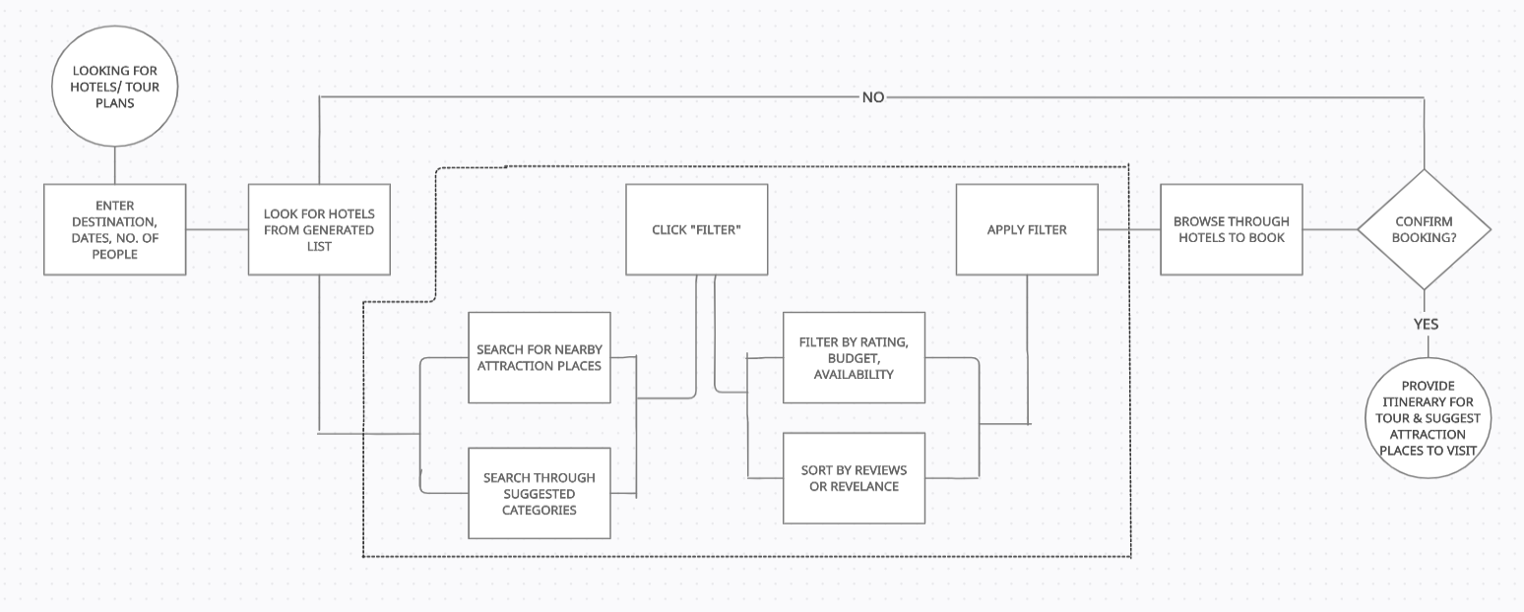
Proposed System Architecture/Working

Slide 9
Implementation Status
Built frontend : Home page, Hotels page, Flight booking page, About us page, Contact page, Recommendation page
Working on implementing API to get the relevant data on backend
Working on implementing an AI chatbot that can provide users with simple answers for any queries

Slide 10
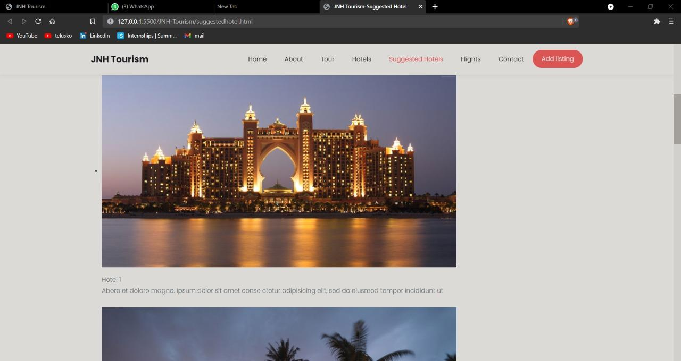
Page : Suggested Hotel

Slide 11
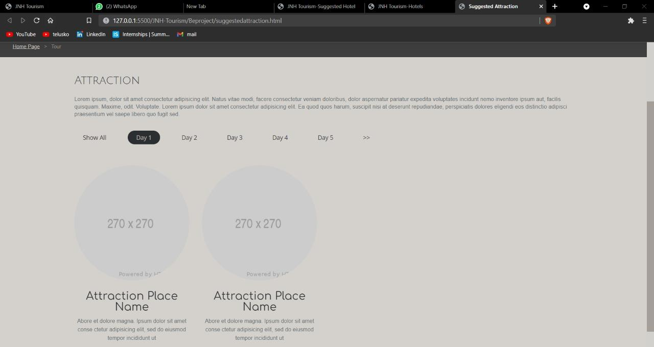
Page : Suggested Attraction

Slide 12
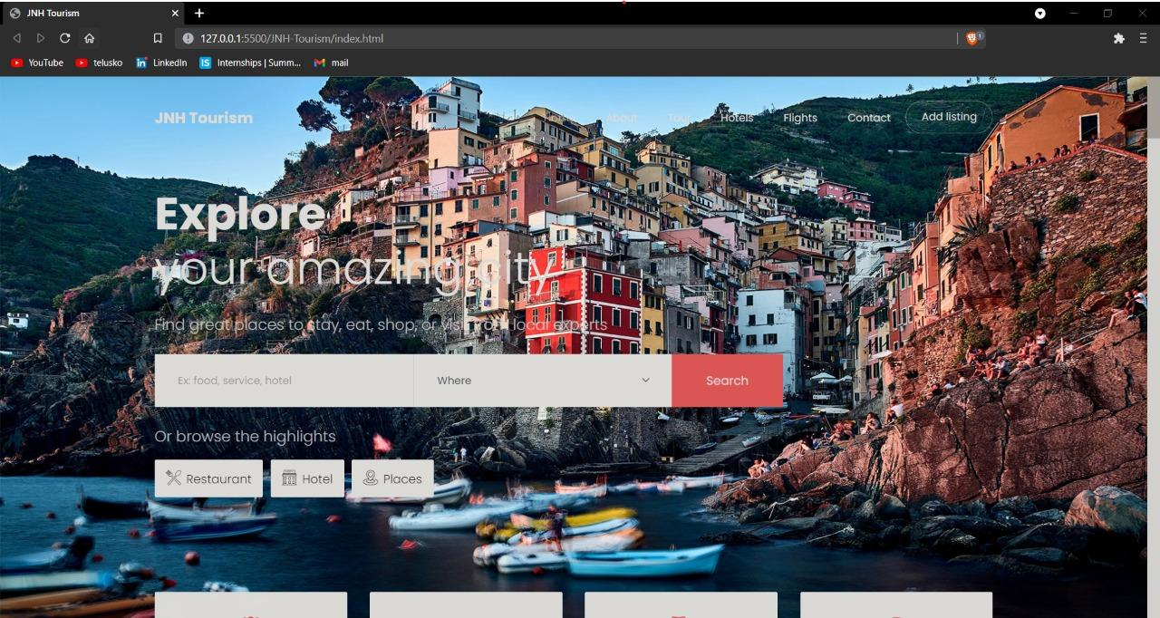
Page : Hotel Search

Slide 13
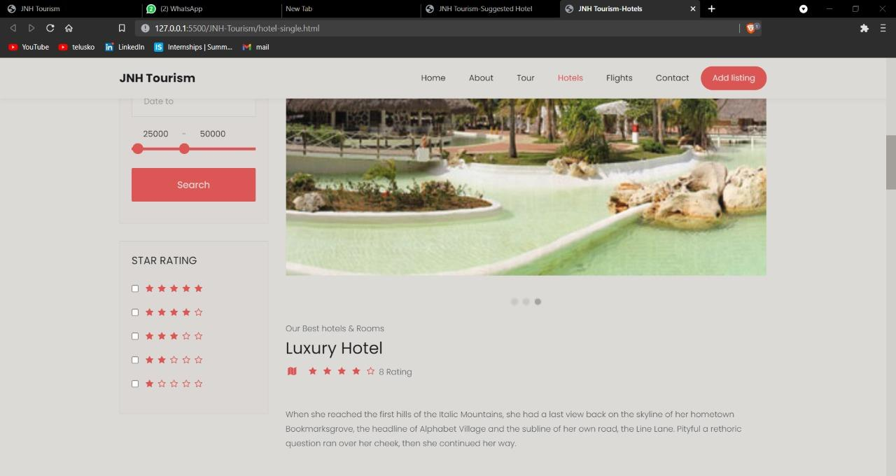
Page : Hotel Details

Slide 14
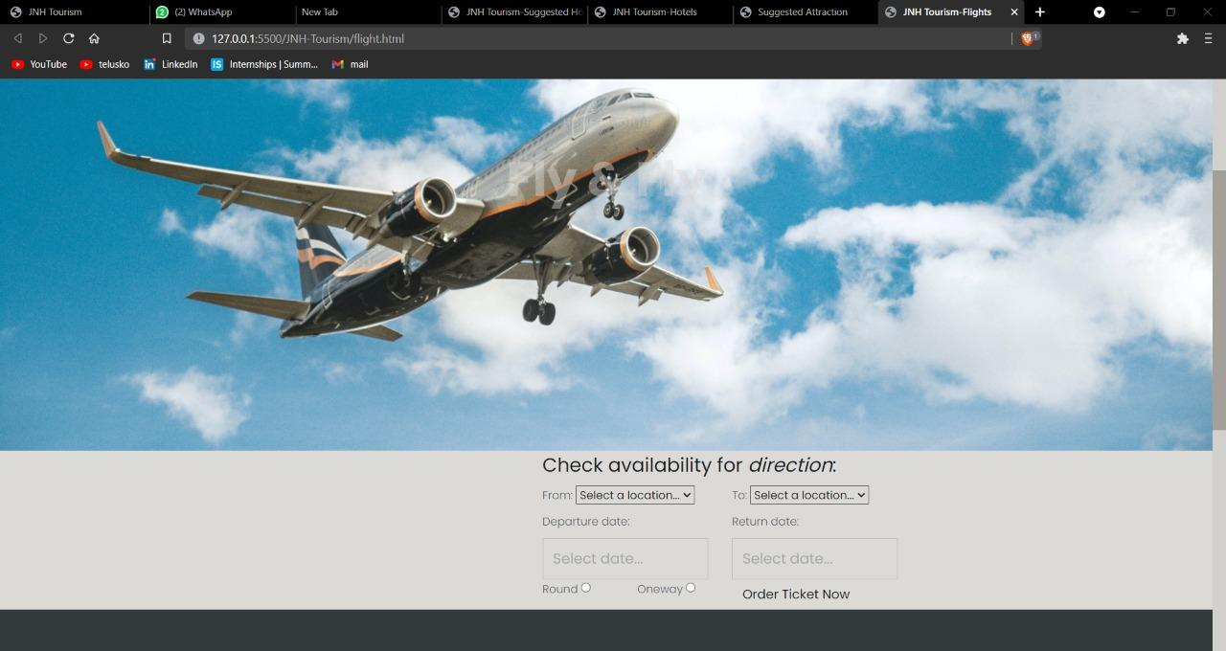
Page : Flight Booking

Slide 15
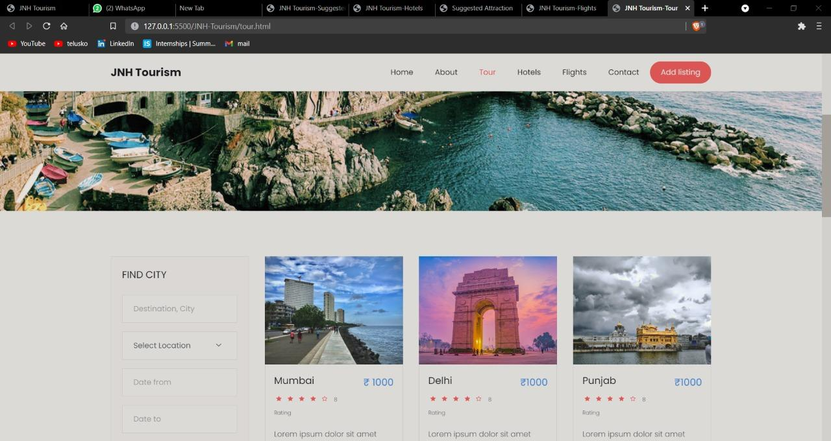
Page : Tour Packages

Slide 16
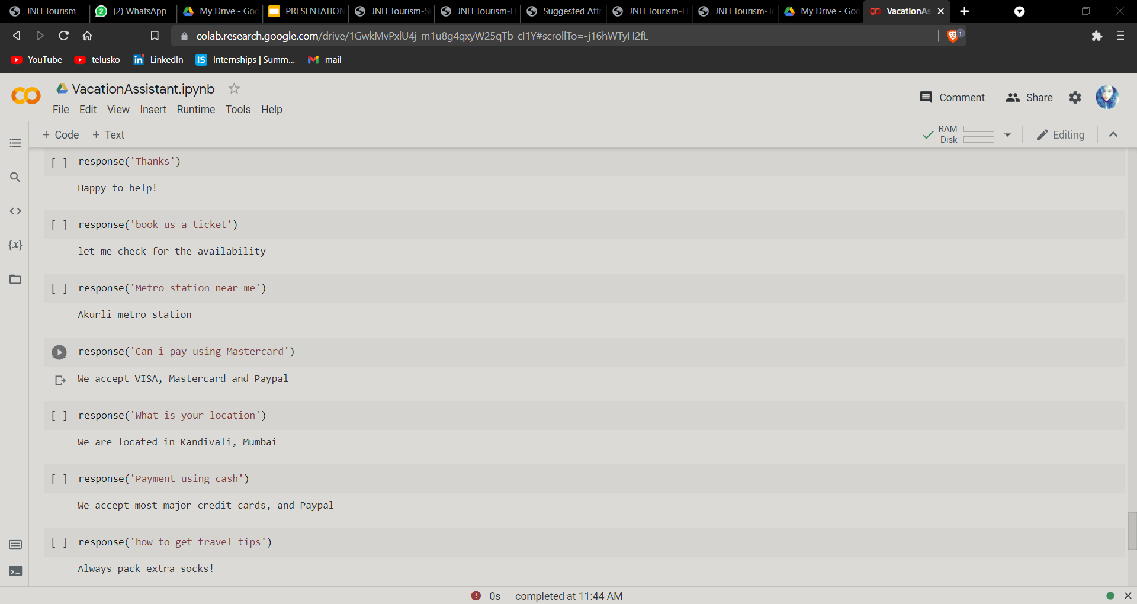
Chatbot

Slide 17
References
Shafiee, M. M., Rahimzadeh, S., & Haghighizade, R. (2016). The effect of implementing SEO techniques and websites design methods on e-tourism development: A study of travel agencies e-tourism websites. 2016 10th International Conference on e-Commerce in Developing Countries: With Focus on e-Tourism (ECDC). doi:10.1109/ecdc.2016.7492963
Aw Yoke Cheng, & Ab Hamid, N. R. (2011). Behaviour and preferences in browsing the travel and tourism websites. 2011 IEEE Colloquium on Humanities, Science and Engineering. doi:10.1109/chuser.2011.6163731
Smart Travel Planner: A mashup of travel-related web services. 2013 International Conference on Current Trends in Information Technology (CTIT). doi:10.1109/ctit.2013.6749499
Sebastia, L., Garcia, I., Onaindia, E., & Guzman, C. (2008). e-Tourism: A Tourist Recommendation and Planning Application. 2008 20th IEEE International Conference on Tools with Artificial Intelligence. doi:10.1109/ictai.2008.18
Barranco M.J., Noguera J.M., Castro J., Martínez L. (2012) A Context-Aware Mobile Recommender System Based on Location and Trajectory. In: Casillas J., Martínez-López F., Corchado Rodríguez J. (eds) Management Intelligent Systems. Advances in Intelligent Systems and Computing, vol 171. Springer, Berlin, Heidelberg. https://doi.org/10.1007/978-3-642-30864-2_15
Pazzani M.J., Billsus D. (2007) Content-Based Recommendation Systems. In: Brusilovsky P., Kobsa A., Nejdl W. (eds) The Adaptive Web. Lecture Notes in Computer Science, vol 4321. Springer, Berlin, Heidelberg. https://doi.org/10.1007/978-3-540-72079-9_10
De Nart D., Ferrara F., Tasso C. (2013) Personalized Access to Scientific Publications: from Recommendation to Explanation. In: Carberry S., Weibelzahl S., Micarelli A., Semeraro G. (eds) User Modeling, Adaptation, and Personalization. UMAP 2013. Lecture Notes in Computer Science, vol 7899. Springer, Berlin, Heidelberg. https://doi.org/10.1007/978-3-642-38844-6_26

Slide 18
Thank You...!!

